Slide 1
Getting Started with Azure SQL Database!
Jim Donahoe

Slide 2




A Little About Me!
DBA(Does ‘Bout Anything) | Video Game Enthusiast | Nerd |
Not-so-Big Data | Azure Enthusiast
Meetups: meetup.com/PittsburghSQL/
Email: JamesDonahoe1983@gmail.com
Twitter: @SQLFlipFlopsDBA

Slide 3
Agenda
What is Azure SQL Database?
Configuration
Firewall Configuration
Auditing/Threat Detection
Automatic Tuning
Alert configurations
Geo-Replication setup
Maintenance for Azure SQL Database
Resource locks

Slide 4

Important thing to remember is:

Slide 5
What are the … as a Service and What do they mean?

Slide 6
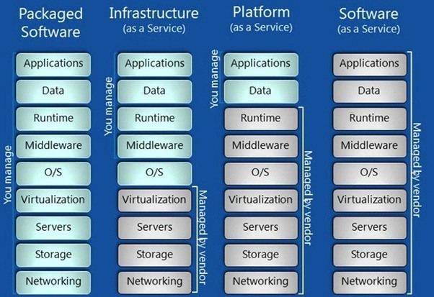

Slide 7

What is Azure SQL Database?
Notes:
Database-as-a-service (DbaaS) is a cloud computing service model that provides users with some form of access to a database without the need for setting up physical hardware, installing software or configuring for performance. A cloud database is a database that typically runs on a cloud computing platform, access to it is provided as a service. Database services take care of scalability and high availability of the database.
https://en.wikipedia.org/wiki/Cloud_database

Slide 8

Definition
Database-as-a-service (DBaaS) is a cloud computing service model that provides users with some form of access to a database without the need for setting up physical hardware, installing software or configuring for performance. A cloud database is a database that typically runs on a cloud computing platform, access to it is provided as a service. Database services take care of scalability and high availability of the database.
https://en.wikipedia.org/wiki/Cloud_database

Slide 9

Configuration

Slide 10
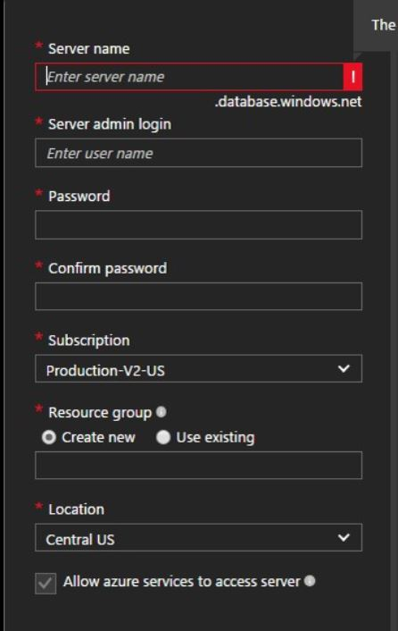
Configuration
Deploying from Azure Portal:
Name your server accordingly:
Choose a strong username & password:
Choose the subscription to deploy to:
Create a new Resource Group or use an existing one:
Choose the Azure Data Center you want this hosted at:
Do you want Azure services to access this instance?

Slide 11

Firewall Configuration

Slide 12
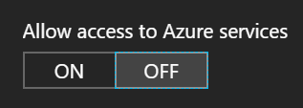
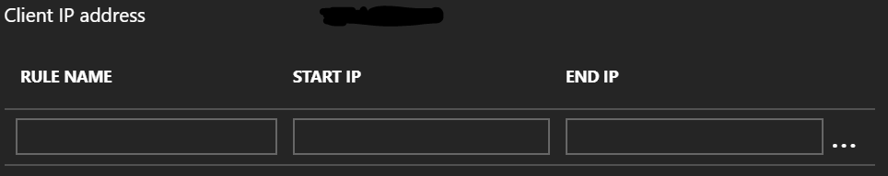
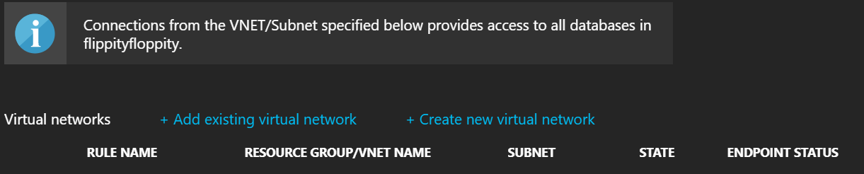
Firewall Configuration
If you turn this on, this allows access from ALL/ANY Azure services in your current subscription!
Here you can input the IP Addresses of computers/servers that you want to access your instance. You can set these to ranges and your existing VNET’s as well.
Notes:
One of the important settings here is the “Allow acess to Azure services”. The important thing to remember with this is, it allows access from ANY Azure services(not just the ones in the subscription the DBaaS instance is configured in).

Slide 13
Demo

Slide 14

Auditing/Threat Detection

Slide 15
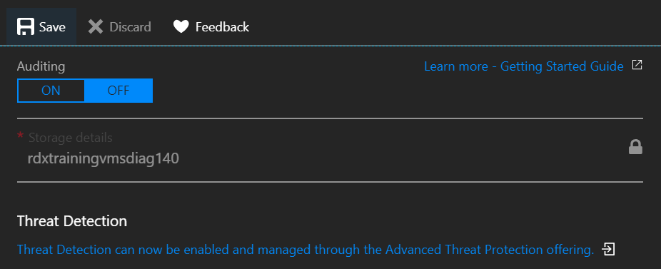
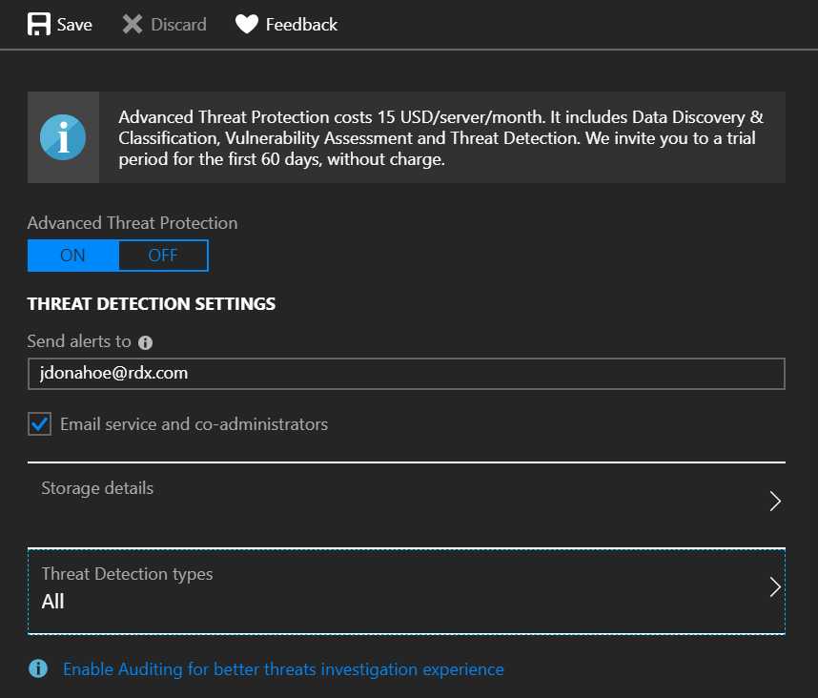
Auditing/Threat Detection
MS Walkthrough
This service costs $15 a month per server. It is a great tool, and well worth the money. You are alerted via email for ANY security issue from Microsoft. See the MS Walkthrough link for specifics!

Slide 16

Automatic Tuning

Slide 17
Automatic Index Management
How many of you have ever manually added an index to see if it speeds up your operations?
How much time do you spend doing that on a weekly basis?
How much time do you spend doing performance research weekly?
Trust but verify – Enable on a test set of data first(Enabled per server, or at database level).
Notes:
Why automatic tuning? One of the main tasks in classic database administration is monitoring the workload, identifying critical SQL queries, indexes that should be added to improve performance, and rarely used indexes. Azure SQL Database provides detailed insight into the queries and indexes that you need to monitor. However, constantly monitoring database is a hard and tedious task, especially when dealing with many databases. Managing a huge number of databases might be impossible to do efficiently even with all available tools and reports that Azure SQL Database and Azure portal provide. Instead of monitoring and tuning your database manually, you might consider delegating some of the monitoring and tuning actions to Azure SQL Database using automatic tuning feature.

Slide 18

How does this actually work!?
Azure SQL Database has a continuous performance monitoring and analysis process that constantly learns about the characteristic of your workload and identify potential issues and improvements.
This process enables Azure SQL Database to dynamically adapt to your workload by finding what indexes and plans might improve performance of your workloads and what indexes affect your workloads. Based on these findings, automatic tuning applies tuning actions that improve performance of your workload. In addition, Azure SQL Database continuously monitors performance after any change made by automatic tuning to ensure that it improves performance of your workload. Any action that didn’t improve performance is automatically reverted. This verification process is a key feature that ensures that any change made by automatic tuning does not decrease the performance of your workload.
There are two automatic tuning aspects that are available in Azure SQL Database:
Automatic index management that identifies indexes that should be added in your database, and indexes that should be removed.
Notes:
Any Create index recommendation has a back off policy that won’t allow applying the recommendation if the database or pool DTU usage was above 80% in last 20 minutes or if the storage is above 90% of usage. In this case, the recommendation will be postponed.
Once the create index recommendation is applied, Azure SQL Database will compare performance of the queries with the baseline performance. If new index brought improvements in the performance, recommendation will be flagged as successful and impact report will be available. In case the index didn’t bring the benefits, it will be automatically reverted. This way Azure SQL Database ensures that using recommendations will only improve the database performance.

Slide 19
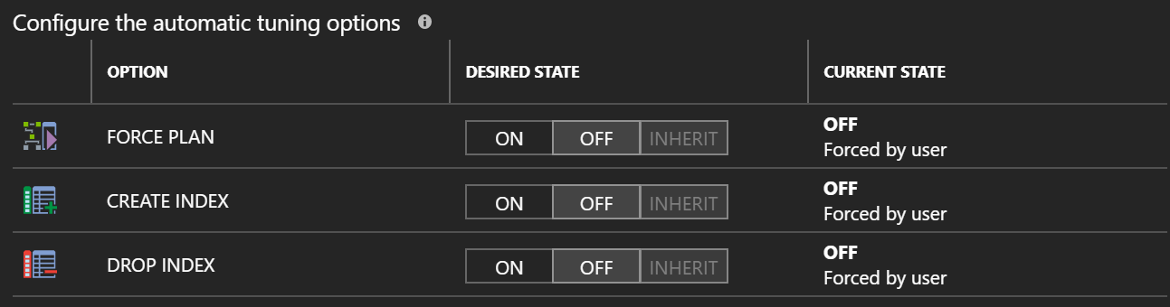
https://docs.microsoft.com/en-us/azure/sql-database/sql-database-automatic-tuning
Notes:
This can be configured at both Server level and Database level. If enabled at the server level, each new database will automatically have it enabled upon creation.

Slide 20

Alerting

Slide 21
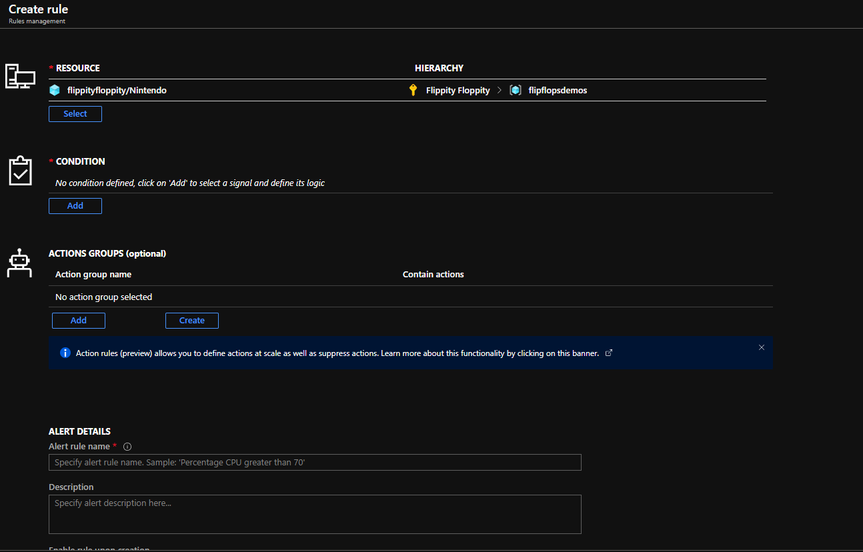
Alerting
Important thing to know is that alerts in DBaaS are per database, not per instance.

Slide 22
Demo

Slide 23
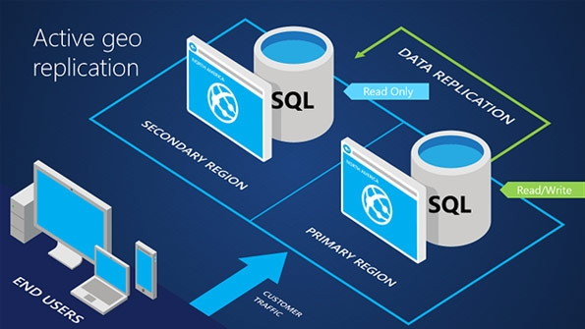
Geo-Replication Setup

Slide 24
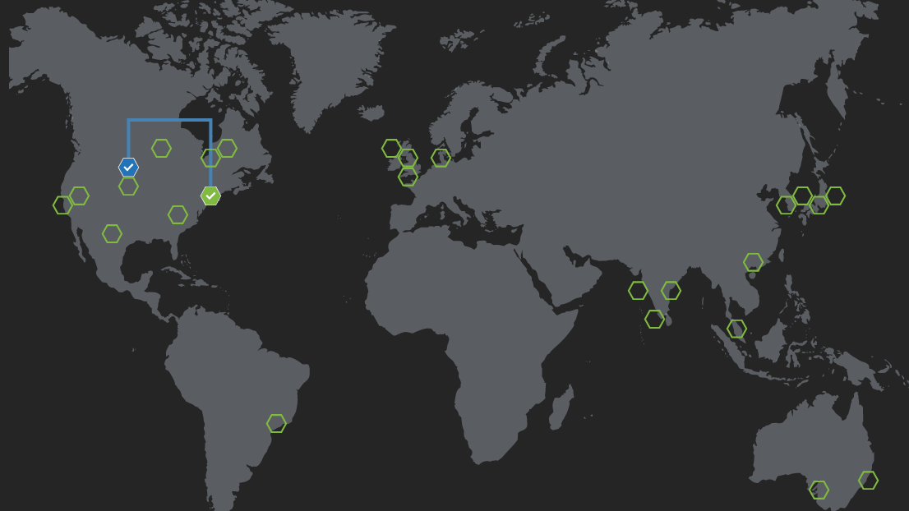
Geo-Replication Setup
What if I told you that you can configure your DBaaS to be HA in seconds?
What if I told you that you can configure your DR for DBaaS in seconds?
What if I told you that you can do this ALL through the Azure Portal?
Notes:
Disaster recovery(DR) documentation and processes are critical to maintaining server and service availability with minimal impact. Failure to maintain good disaster recovery documentation and processes could lead to small problems becoming disasters and disasters becoming unrecoverable failures. Disaster Recovery Plan should be tested and practiced regularly(At LEAST every six months)

Slide 25
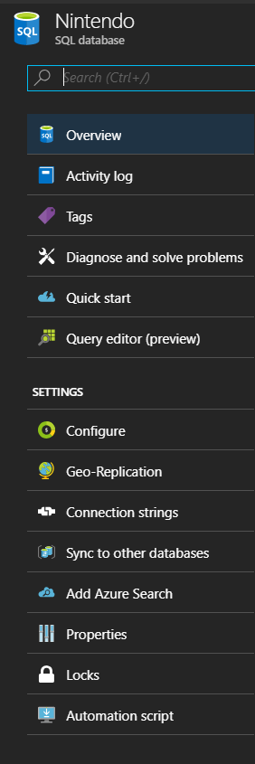

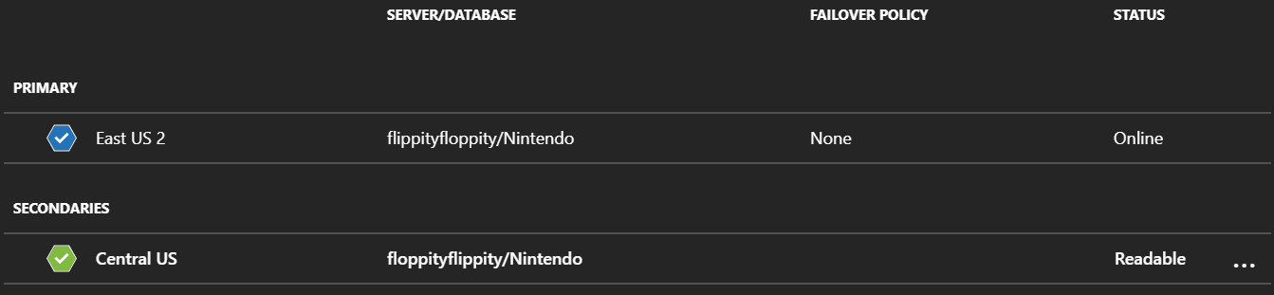
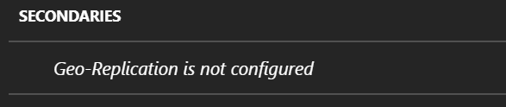
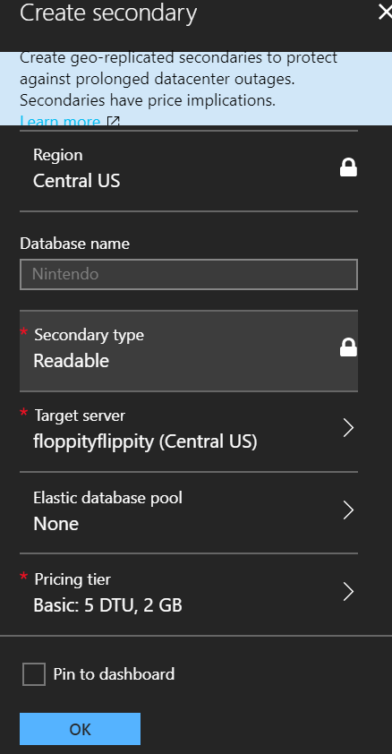
Setup Flowchart

Slide 26
Failover Groups

Slide 27
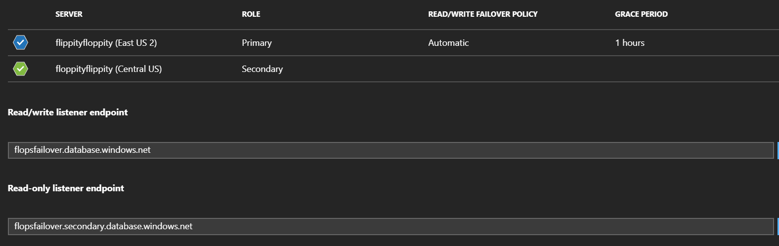
Failover Groups
Utilizing Geo-Replication still requires a manual intervention of updating connection strings to repoint your application from the Primary, to the Secondary in the event of a failover. Using a Failover Group, you configure one address, and in the event Primary fails, the connection string does not need to be updated. Think of this as a Listener in your Always On Group.

Slide 28
Demo

Slide 29
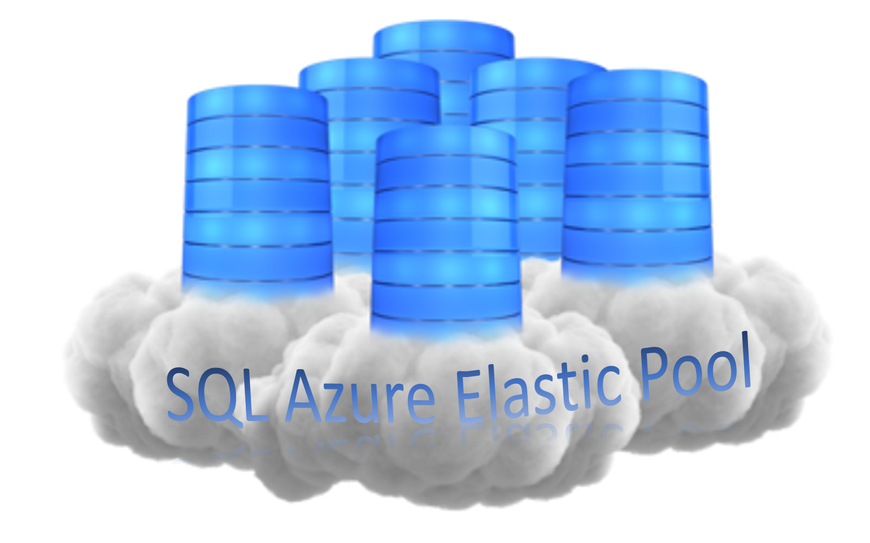
Elastic Pools

Slide 30
Elastic Pools
What is an Elastic Pool?
SQL Database elastic pools are a simple, cost-effective solution for managing and scaling multiple databases that have varying and unpredictable usage demands. The databases in an elastic pool are on a single Azure SQL Database server and share a set number of resources (eDTUs) at a set price. Elastic pools in Azure SQL Database enable SaaS developers to optimize the price performance for a group of databases within a prescribed budget while delivering performance elasticity for each database.
More info can be found here:
Elastic Pool Documentation

Slide 31
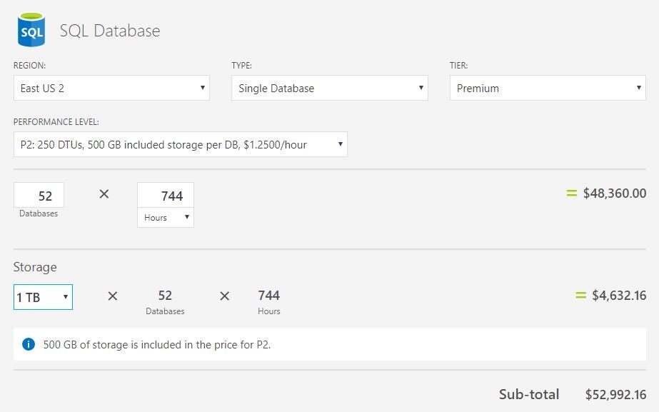
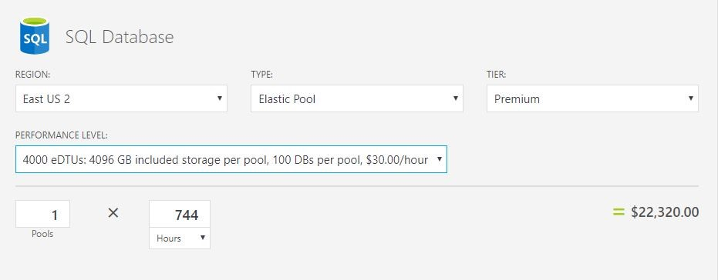
Elastic Pools
A former client of mine utilizes the Elastic Pool functionality/feature for their DBaaS instances in Production. The main reason for this is cost. See the below cost estimates with Elastic Pool, and without Elastic Pool.

Slide 32

Maintenance for DBaaS

Slide 33
Maintenance
Backups/Integrity Checks
Microsoft handles the backups(Weekly Full, Hourly Differentials, T-logs every 5 minutes)
Indexes/Statistics
Index/Statistic maintenance is still performed by the end user/client.
Azure Maintenance Blog Post
The common way of performing custom maintenance(Indexes) is through Automation Run Books.

Slide 34
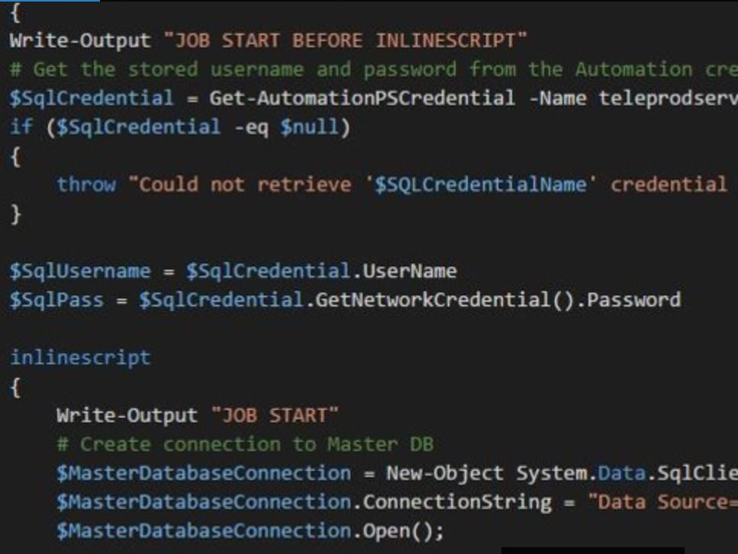
Maintenance(cont.)
Automation Job

Slide 35
Maintenance(cont.)
Elastic Job Agent
The service itself is free. However, you need to pay for the database that stores all of the service related information. This database needs to be at an S1 level or higher. By using the Azure Calculator, you can see what this database would cost in your region. It’s generally around $30 a month.
Azure Calculator link: Azure Calculator
It works very well once you get past the setup. The security behind it is what I find to be the trickiest part, but once you grasp the concept, it works flawlessly. OLA Hallengren scripts can be used here as well!
Learn about the Elastic Job Agent here!

Slide 36
Bonus Features!
Transparent Data Encryption(TDE) is enabled by default at no extra cost to you!
Query Store is enabled by default for ALL databases(Basic/Standard/Premium)
Dynamic Data Masking available across ALL database tiers(Basic/Standard/Premium)
Free database to use every month! See here for details: Free Database Details

Slide 37

Resource locks
Notes:
Go through

Slide 38
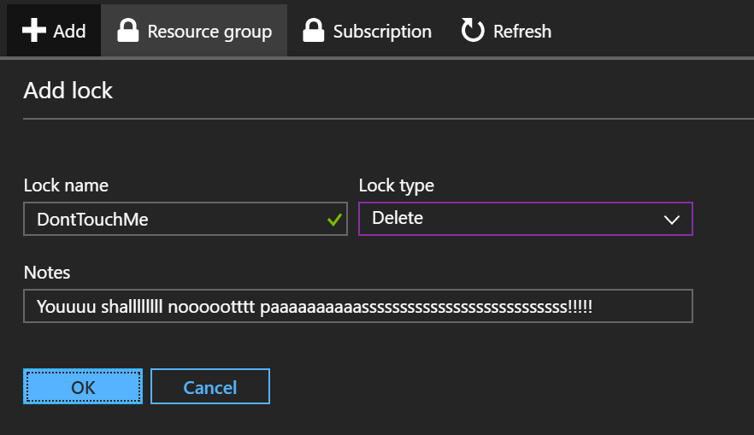
Resource Locks
As an administrator, you may need to lock a subscription, resource group, or resource to prevent other users in your organization from accidentally deleting or modifying critical resources
Two types:
Delete - means authorized users can still read and modify a resource, but they can't delete the resource.
ReadOnly - means authorized users can read a resource, but they can't delete or update the resource. Applying this lock is similar to restricting all authorized users to the permissions granted by the Reader role. THIS IS BAD FOR DBaaS!!

Slide 39
Resources
Local Pass Chapter
Ask your question there, get the speakers contact information and don’t be afraid to reach out to them.
Twitter
#SQLHELP, #SQLFAMILY Reaching out to any of those hashtags will get you a response relatively quickly if you are working on something
Advanced Threat Protection – Vulnerability Scan
This walkthrough helps you setup and have your first assessment run against your Azure SQL Database instance. It is free for the first 60 days(Storage accounts are not included in that free package)
Allan Hirt - sqlha.com
Great blog posts on DR strategies, pitfalls, misconceptions

Slide 40
SentryOne(Now SolarWinds)
I cannot stress how great PlanExplorer is! It is COMPLETELY free now! There used to be a free and paid, but they combined the two. Powerful tool for Execution Plan reading.
Virtual Pass Chapters
These chapters hold virtual meetings every month for their subject(In-Memory, Performance, Administration, etc). Register on SQLPASS.org and look into them, lots of great, knowledgeable speakers regularly present! --Shameless Plug, In-Memory VC has a great leader, just sayin. ;)
Learn.Microsoft.Com
Free training for all Azure topics(Networking, SQL, VM)

Slide 41

Questions?

Slide 42


Thank you ALL for attending!
https://www.vanityfair.com/hollywood/2018/01/albuquerque-breaking-bad-tourism-10th-anniversary
https://chuckjones.com/product/left-at-albuquerque/

